Slide 1
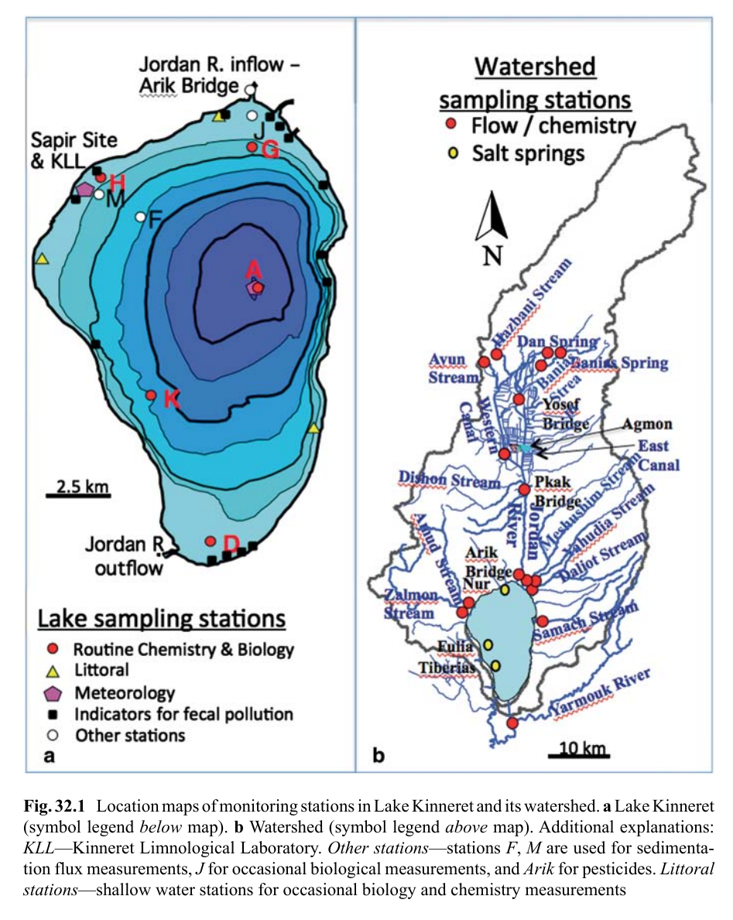
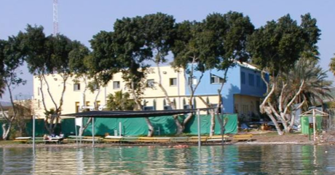
Lake Kinneret
Latitude: 32°N\Longitude: 35°E
Altitude: -210 m
Length: 21 km
Width: 12 km
Mean depth: 20 m
Max depth: 42 m
Area: 170 km²
Volume: 4300 x 10⁶ m³
Jordan R annual inflow: 310 x 10⁶ m³
Watershed area: 2730 km
-20
-30
-40
Notes:
<number>

Slide 2
Observations
Source | Data type | Spatial resolution | Time resolution | Time span
IMS (Israel Meteorological Service) | Air temperature and precipitation | IMS stations | Daily | 1950-2024
KLL | Lake Kinneret Temperature, Salinity, Chl, Nutrients, Fluorescence, phytoplankton counts | 5 Lake monitoring stations | Weekly | 1970-2024
Mekorot & IWA (Israel Water Authority) | Streams temperature, conductivity and chemistry. | Rivers inlets | Weekly | 1970-2024
IWA | Stream discharge and Lake level | Rivers inlets | Daily | 1970-2024

Slide 3
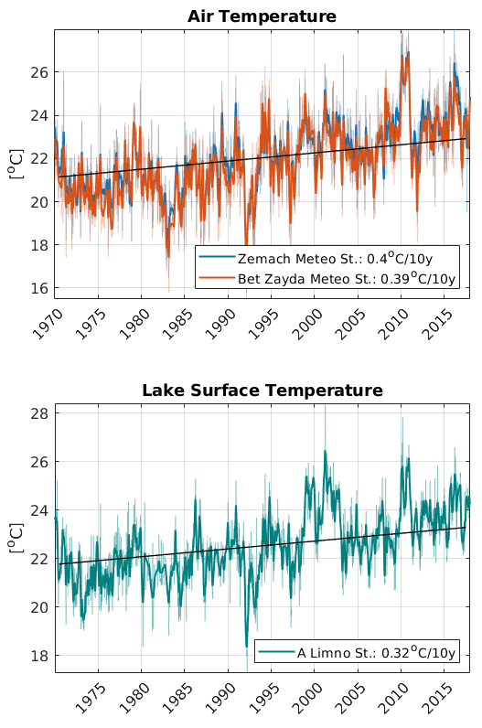
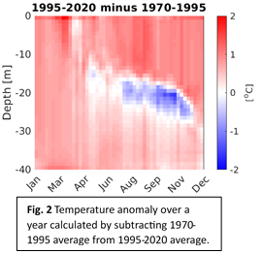
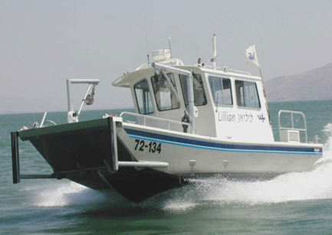
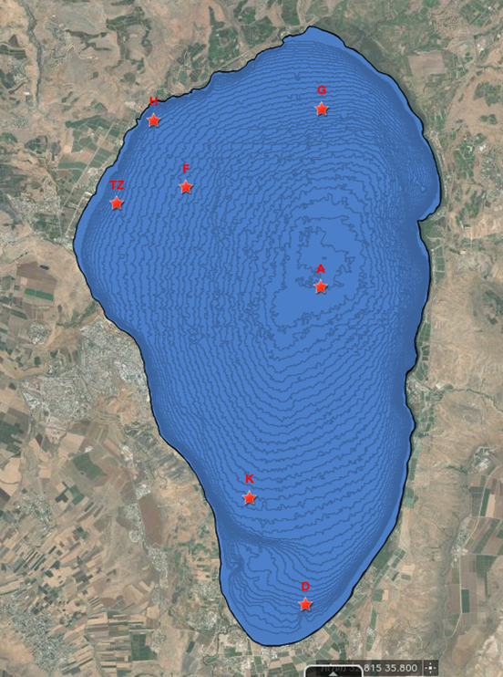
Monitoring Lake Kinneret for the last 50 years
Weekly profiles of T, EC, Chl, Oxygen and more
Anomalies show a warmer and more stratified water column
A

Slide 4
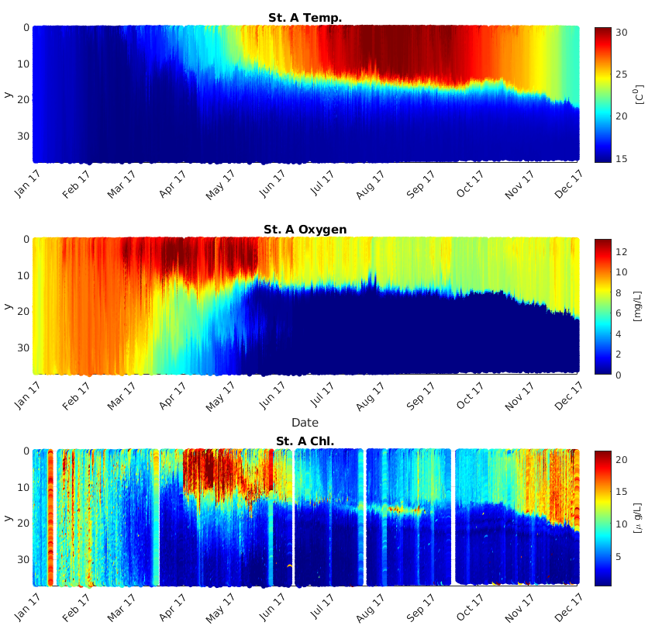
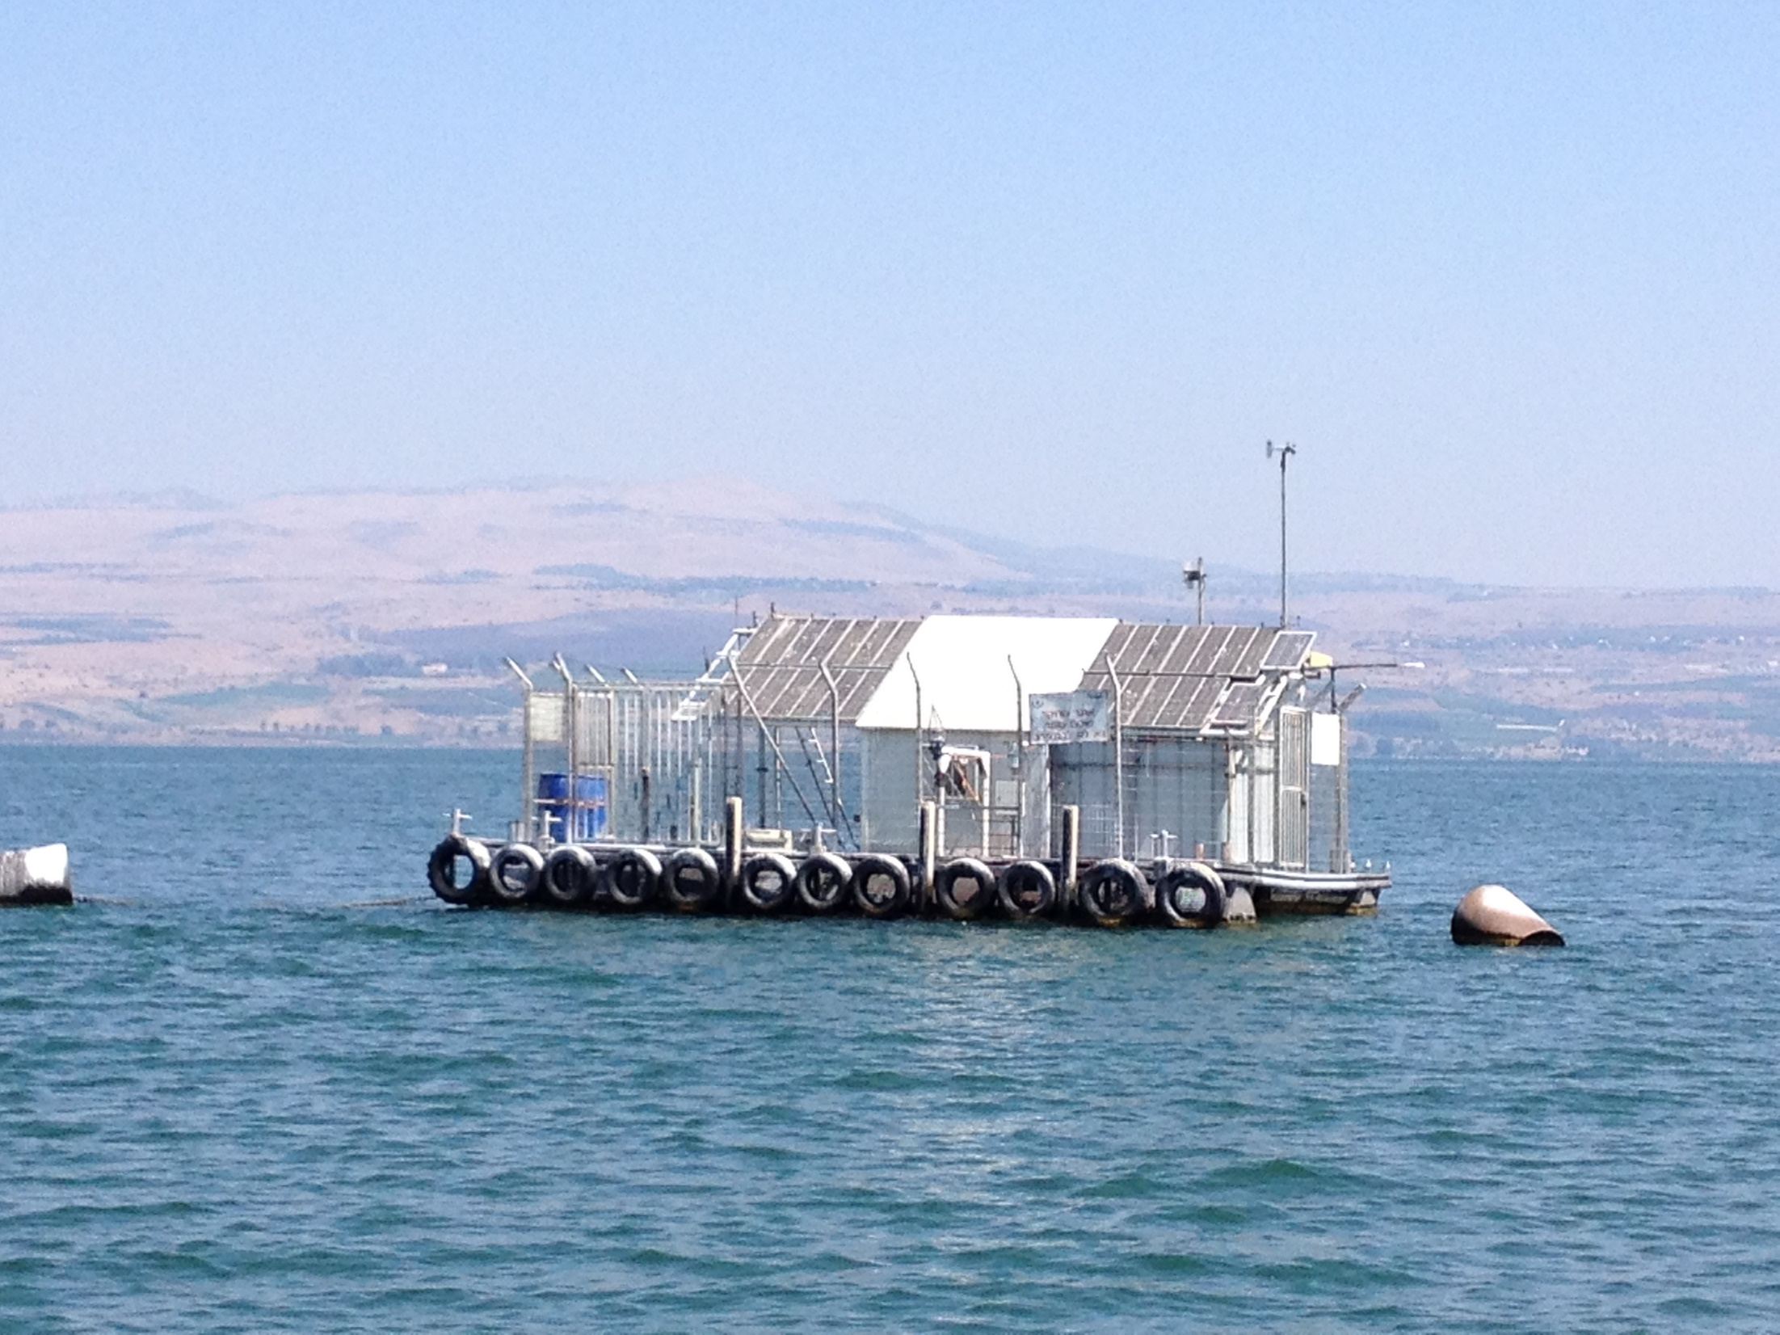
Stratification and the ecological system
3 profiles/day:
Temperature
Conductivity
pH
Dissolved oxygen
Chlorophyll
Turbidity
---------------
Met station
Dust samplers
“Ecoraft”
At Sta. A
A
http://www.ocean.org.il/

Slide 5
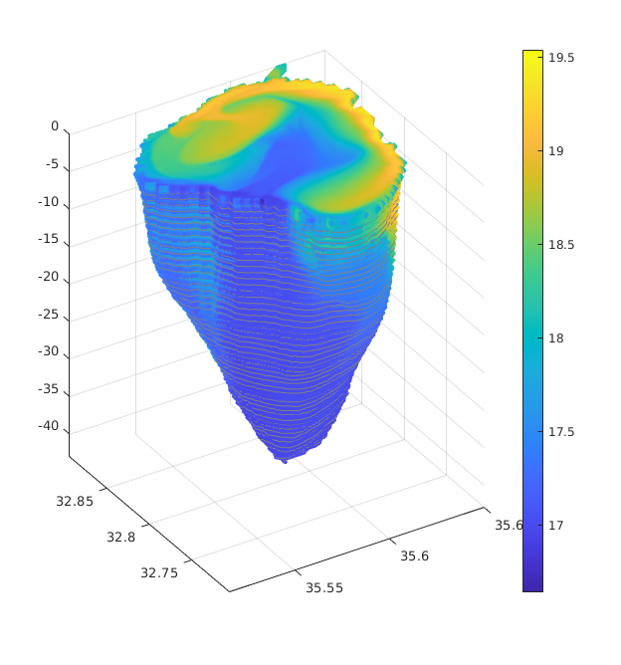
MITgcm hydrodynamical model of Lake Kinneret
Adjusted to Lake Kinneret in resolution of 400 × 400 m (or 100 × 100 m) and 47 vertical layers
Initial conditions of state parameters (T and S) from lake monitoring program
Boundary conditions from atmospheric measurements (air T, air RH, long and short wave radiation), COSMO model (surface winds) and observed rivers discharge and river water properties
Output water temperature, salinity, currents of the 3D domain and calculated fluxes (BULK formula)

Slide 6
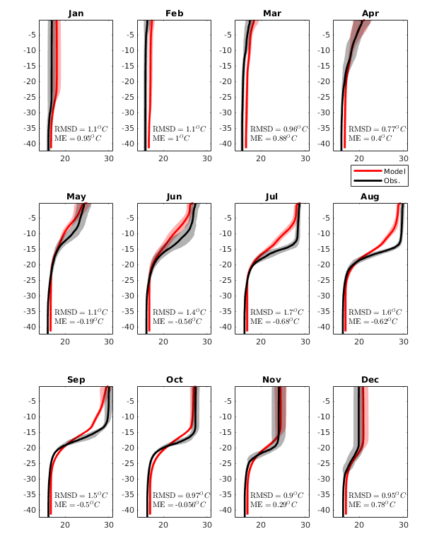
Model vertical validation
Temperature profiles weekly sampled in station A (the deepest monitoring st. in the lake) vs. corresponding modelled profiles over 2019-2021
The comparison show a good representation according to statistical indexes
Root Mean Square Deviation
$RMSD=\sqrt{\frac{1}{N}\sum_{i=1}^{N}{{\left(M_{i}−O_{i}\right)}^{2}}}$
Mean Error
$ME=\frac{1}{N}\sum_{i=1}^{N}{\left(M_{i}−O_{i}\right)}$
$M_{i}−modeledvalueattimei$
$O_{i}−observedvalueattimei$

Slide 7
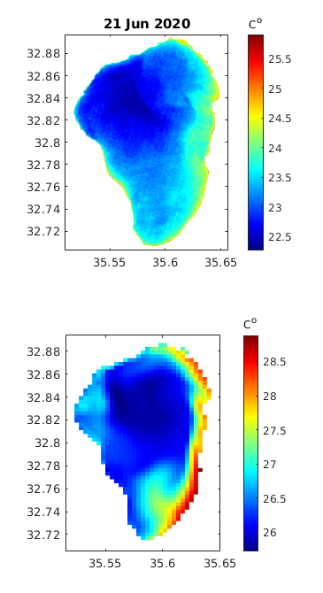
Model spatial validation
Remote sensed data provides spatial observation of Lake Surface Temperature (LST),ChL, TDS etc.
Landsat 8 (every 16 days) and Sentinel 3 (daily) provides reflection from the lake surface in 60 and 300 meter resolution, respectively.
How similar are temperature of the first 1 m and those sensed by satellites?
LandSat 8 LST passing at 11:10 am
Monitoring stations in-situ temperature
H
G
Model 0.25m Temp. at 11:00 am
Date and Time | 1st meter Temp. | Station
21-Jun-2020 07:55:00 | 25.7 | H
21-Jun-2020 08:29:00 | 27 | G
21-Jun-2020 09:14:00 | 26.3 | A
21-Jun-2020 12:07:00 | 28.2 | D
A
D

Slide 8
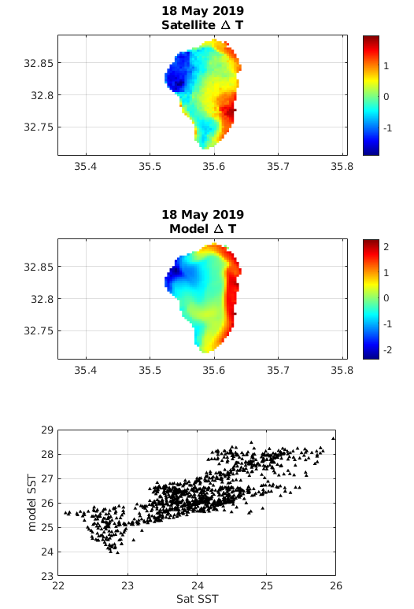
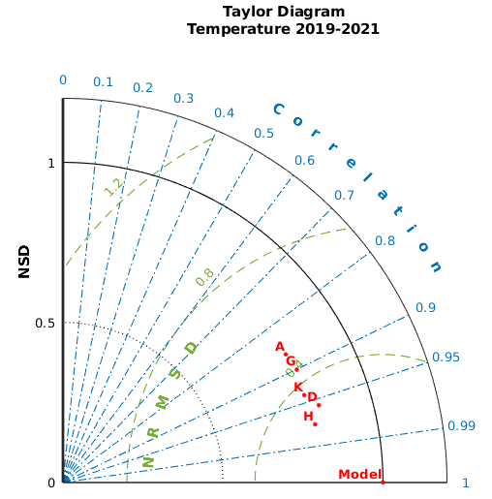
Model spatial validation
$∆T=\left(O_{i}−\overline{O}\right)$
Vs.
$∆T=\left(M_{i}−\overline{M}\right)$
H
G
A
K
D

Slide 9
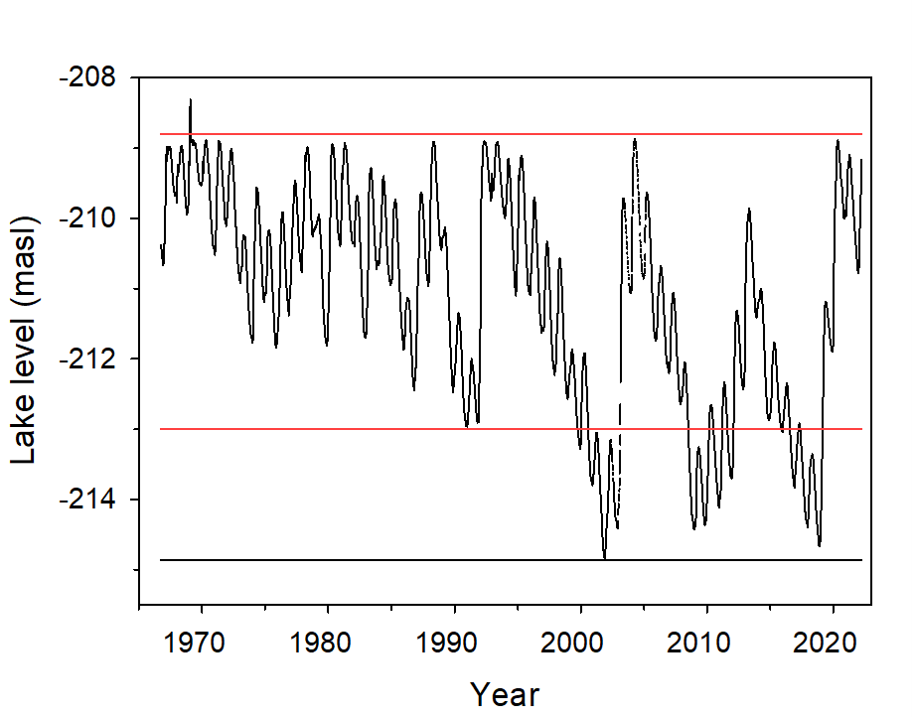
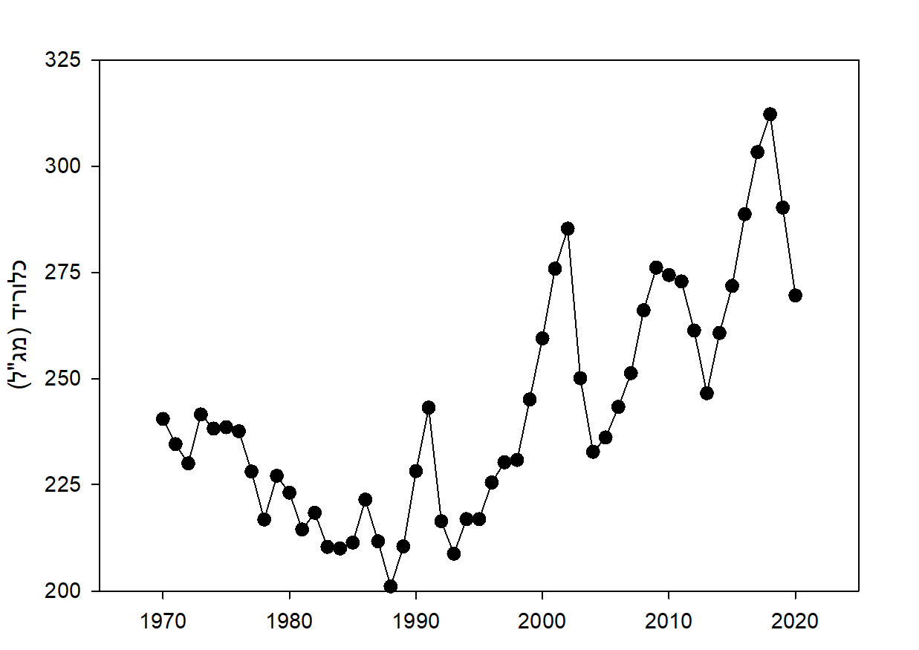
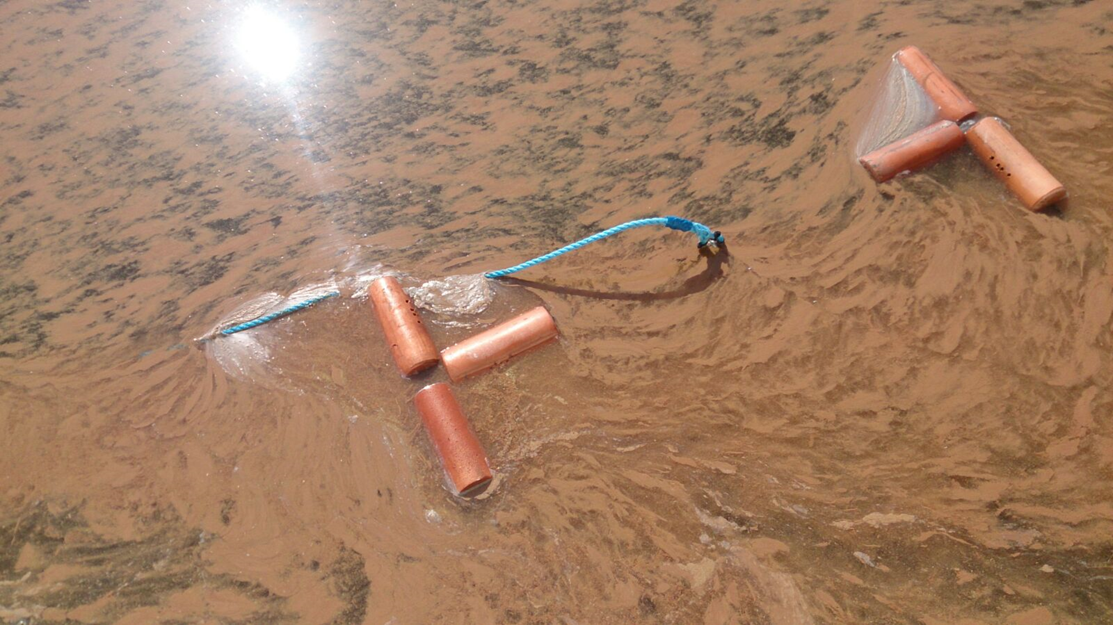
Lake level
Notes:
<number>

Slide 10
Microcystis cyanobacteria- Harmful Algal Bloom – February 2023
When Harmful Algel Bloom is seen in the lake it is usually also seen from space
Using an operational physical model, its spread can be predicted

Slide 11
Microcystis cyanobacteria- Harmful Algal Bloom – February 2023
Extracting atmospheric parameters from the Israeli Meteorological Service for the next 48 hours enable us to follow the Microcystis patch.
The tracking is done by a Lagrangian tracking toolbox, treating the parcels as a passive tracer or with behavior

Slide 12
