Slide 1
MEWS Project Deadlines Year 1

Slide 2
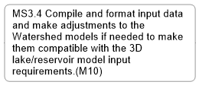
Milestones
WP1
WP2
WP3
WP5
WP4
WP3

Slide 3
Deliverables
WP1
WP2
WP3
WP4
WP5

