Slide 1
Managing Events and Extremes in Water Supplies (MEWS )
Don Pierson
Uppsala University Sweden
don.pierson@ebc.uu.se

Slide 2
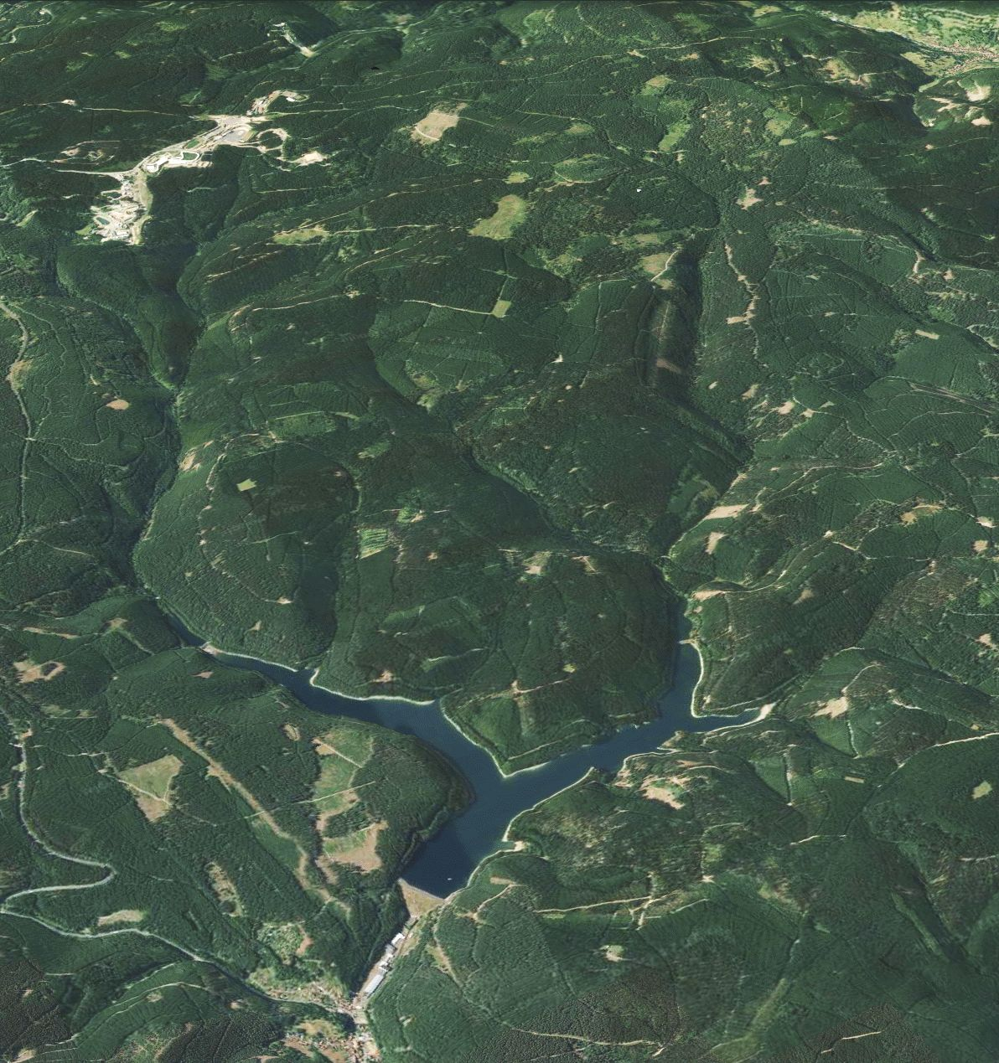
Background – All Extreme Events are not Equal
Ohra Reservoir – Study Site Germany
Drinking water reservoirs are often created in impounded river basins. Major inputs are separated from water supply withdrawal
It is not only event input but the transport and processing of the input that affects water quality at the withdrawal
The effect of an extreme event is not just related to increased precipitation amount, but also antecedent watershed and waterbody conditions:
Soil moisture – Runoff Response
Thermal structure and water level – Reservoir transport and biogeochemistry
Extreme events related to reduced precipitation and reduced water level increase the importance of internal reservoir processes
Antecedent conditions affect not only watershed and water body response but also the coupling between systems.
Antecedent conditions are complexly affected by climate change

Slide 3
Objectives
To develop a freely available comprehensive modelling tool that will allow stakeholders to evaluate the effects of extreme hydro-climatic events on drinking water quality.
To co-develop the modelling system with stakeholders from each demonstration site, including scenarios, workflows, documentation and training
To increase our understanding of the complex regulation of the effects of extreme events and antecedent conditions on water quality at the water supply withdrawal under present and future conditions.

Slide 4
CONSORTIUM DESCRIPTION
All groups in this project have extensive water quality modelling experience and have been at the forefront of lake and reservoir model development.
Uppsala University Sweden & Swedish University of Agricultural Sciences
Consortium coordinator
Issues related to dissolved organic carbon (DOC) and its effect on drinking water treatment
Helmholtz-Centre for Environmental Research Germany
Issues related to dissolved organic carbon (DOC) and eutrophication
Israel Oceanographic Limnological Research
Issues related to water scarcity and eutrophication
Bolding & Bruggeman Denmark
SME specializing in numerical models for lakes and oceans.
Will develop modelling tools and provide modelling support
Centre National de la Recherche Scientifique (CNRS) France
Experts in modelling DOC biogeochemistry

Slide 5
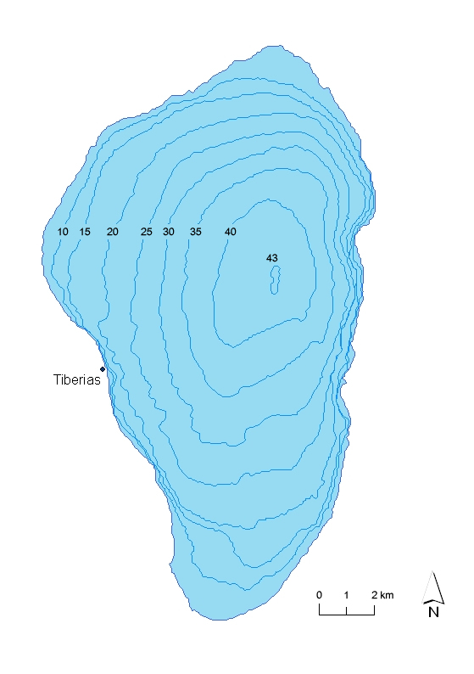
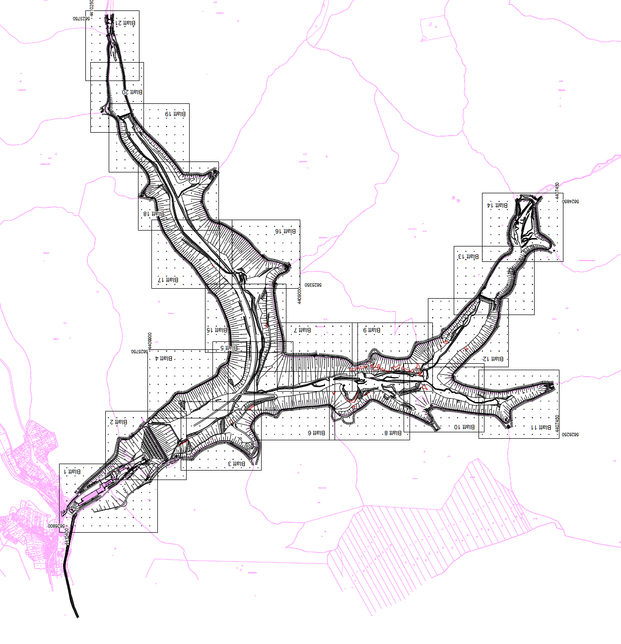
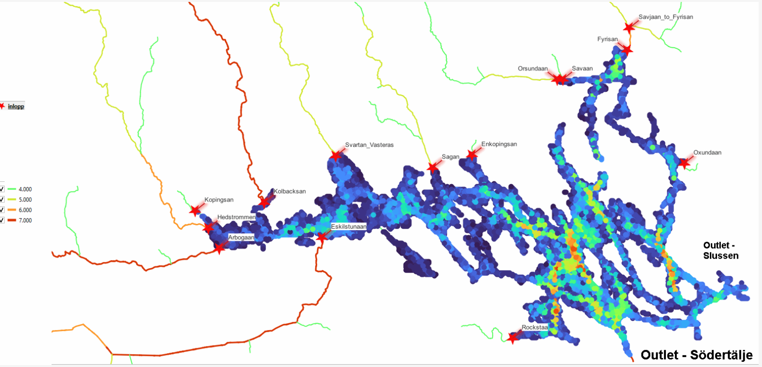
Demonstration Sites
Ohra Reservoir Germany
Lake Mälaren Sweden
Lake Kinneret Israel
Surface Area 0.82 km²
Residence Time ~ 1 yr
Population Served ~ 400 000
Surface Area 1140 km²
Residence Time 2.2 yr
Population Served ~ 2 000 000
Surface Area 166 km²
Residence Time 4.8 yr
Population Served ~ 1 900 00 +
contributions to Jordan

Slide 6
WORK PACKAGE DESCRIPTION
Work Package 1 - GETM and FABM model development and implementation
Implement three fully functional lake/reservoir model setups
Develop a generic modelling system and best practices that will simplify future implementations of the modelling.
Work Package 2 - Biogeochemical model development and implementation
This work package aims to set up biogeochemical models in the three study sites, coupled to the physical models developed in WP 1 using the FABM framework
Work Package 3 - Watershed - Laker/reservoir coupling
To review the available watershed water quality models available at each site. Use these models to produce simulations of historical and future climate watershed input to the lake/reservoir model at each site.
Work Package 4 - Case Study Scenario Development and testing
With stakeholders, co-develop scenarios that will be used for modelling system development and testing, demonstrating the ability to produce short-term forecasts and long-term simulations of climate change effects on drinking water quality. Provide advice and model solutions tailored to specific stakeholder needs.
Work Package 5 – Knowledge transfer
Effectively transfer the models developed by MEWS to the project partners associated with each demonstration site.
Transfer information on model development and provide training in model use to the stakeholders.

Slide 7
EXPECTED IMPACT OF THE PROJECT
Heightened preparedness
A better understanding of the seasonality of events can lead to better preparation for treating events.
Evaluation of possible adaptation to future change
Selective withdrawal - Reservoirs that have multi-level intakes can optimise withdrawal level based on simulations of the vertical distribution of the incoming event water.
For reservoirs that do not have multi-level intakes, simulations of the potential water quality benefits of multi-level withdrawal could help justify future long-term capital investments.
Alternative supplies - Mitigation is most effective when a water supply has multiple source reservoirs that will not be equally affected by the same storm event. In such a case, the proposed modelling system can be used to help define optimal system operations.

Slide 8
Questions

