Slide 1
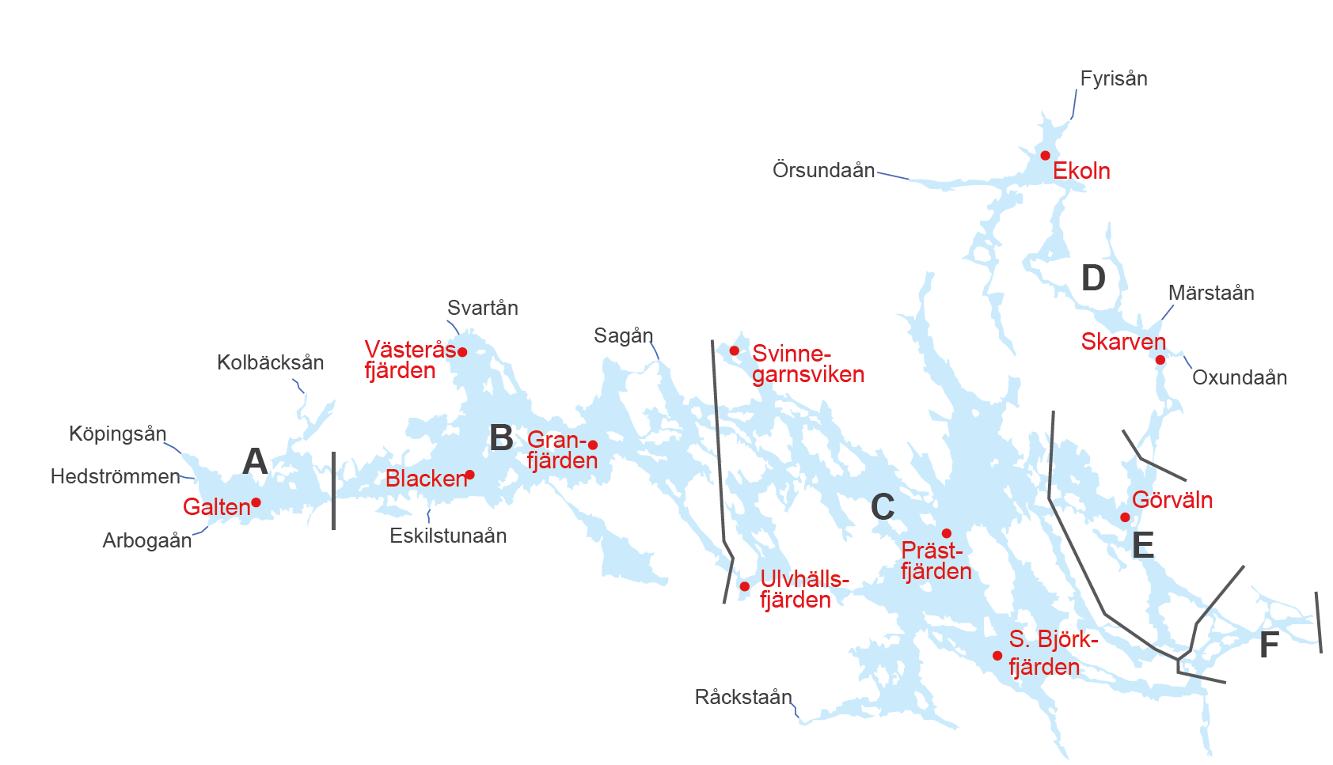
Progress Mälaren – 1D modelling
1D models of 5 basins
Sequential runs; surface outflow of one basin is used as inflow for the next
Aim: Selmaprotbas calibration, maybe also used for scenarios
ISIMIP forcing data, 1995-2015
GOTM-Selmaprotbas settings
Hourly time step
0.5 m layers
3 phytoplankton, 1 zooplankton group
Final version: GWLF inflows driven by same meteorology
E & F
together

Slide 2
Progress Mälaren – 1D modelling
Streams: using discharge from HYPE model from earlier studies
Nutrient concentrations are constant
GSWP3-W5E5 ISIMIP bias-adjusted climate data
Hypsograph extrapolated from Sonesten et al. (2013)
Compiled latest GOTM lake-branch version with Selmaprotbas
Basin exchange resolved during runs
Inflow data/
Compile stream data.R
ISIMIP data/
Compile meteo data.R
Compiled data/
Compile hypsograph data.R
YAML templates and GOTM-SP.exe/
Set up GOTM-SP runs.R
helpers/modify_stream_sections_gotm_yaml.R
helpers/ create_inflow_files_from_basin_outflow.R
Run GOTM-SP for basins.R
Simulation folder/
output.nc files

Slide 3
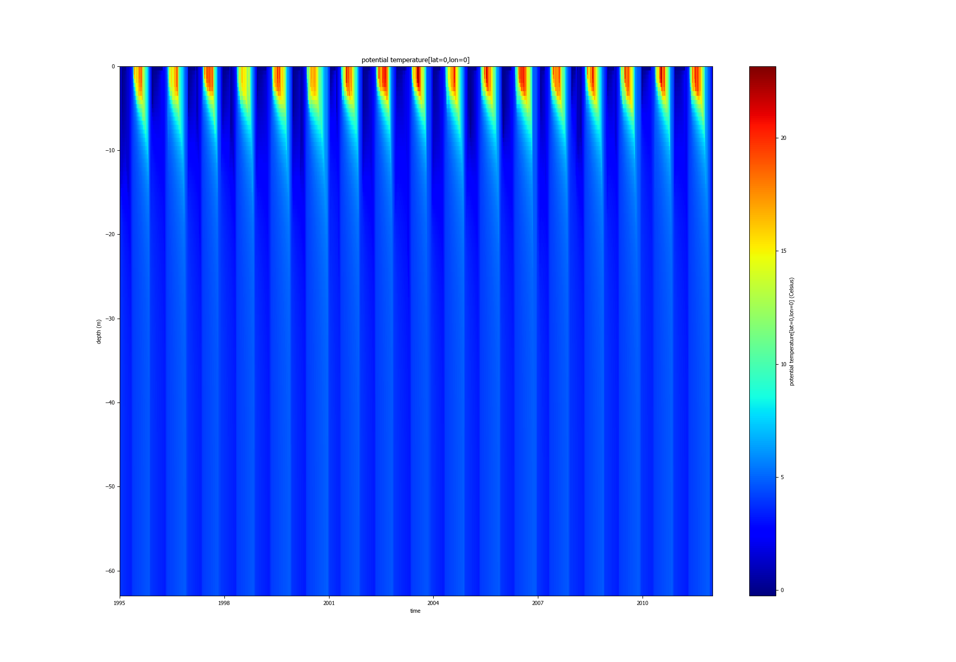
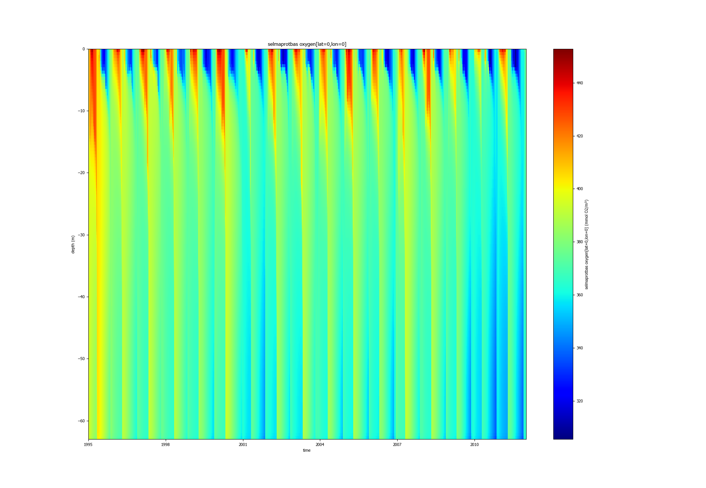
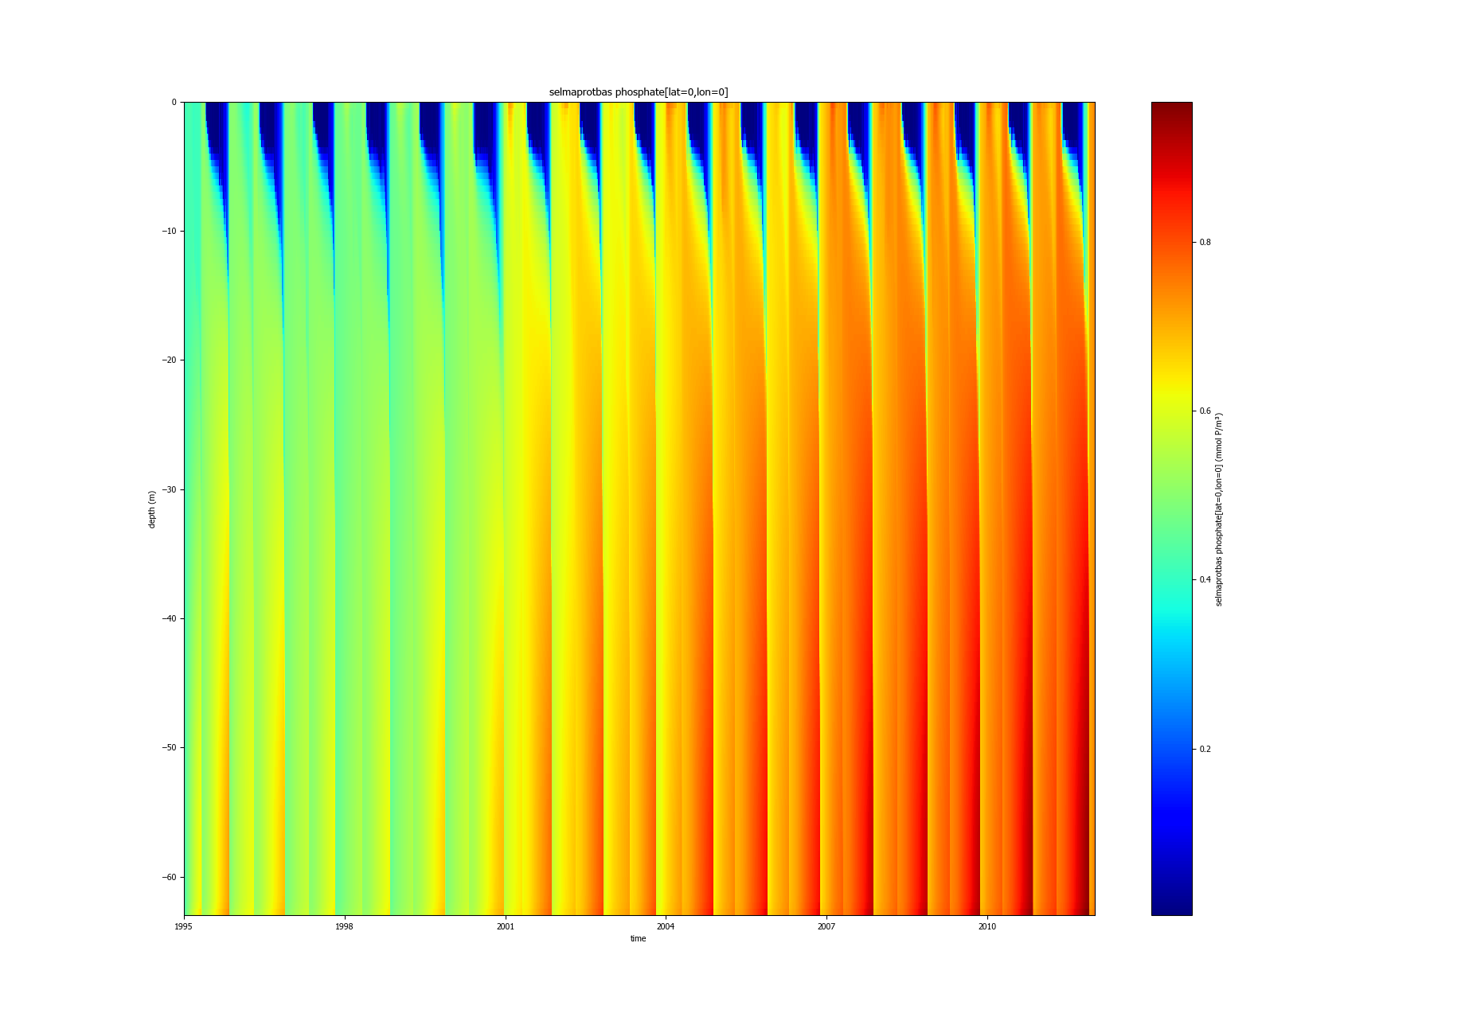
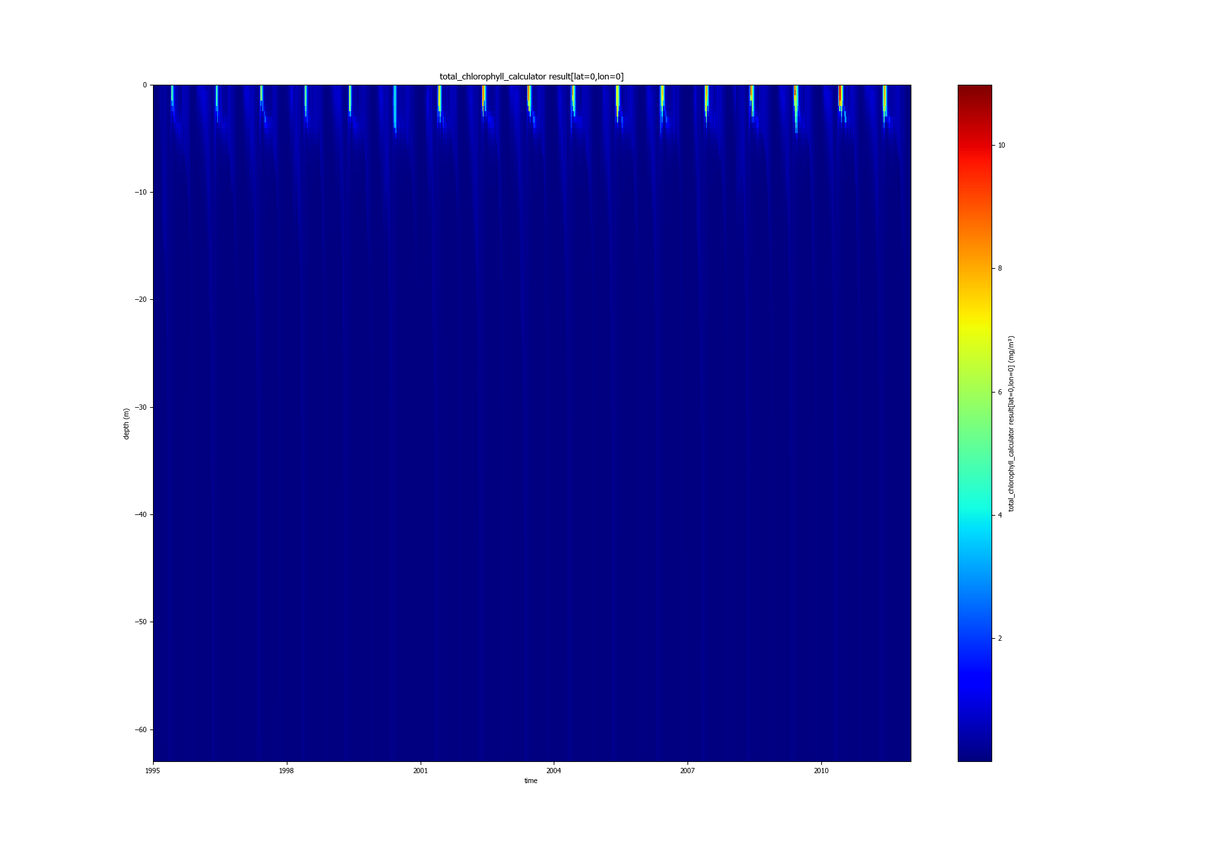
Progress Mälaren – 1D modelling
Temperature
Oxygen
0m
I have not yet compared with observations
Temperature and PO4 look realistic
O2 and NO3 do not
Phytoplankton is growing (up to 10 mg-Chl/m3)
60m
Phosphate
Chlorophyll

