Slide 1
Progress L. Mälaren – Making a bathymetry map
3D models of Lake Mälaren
Bathymetry map
Sweref 99 - local coordinate system

Slide 2
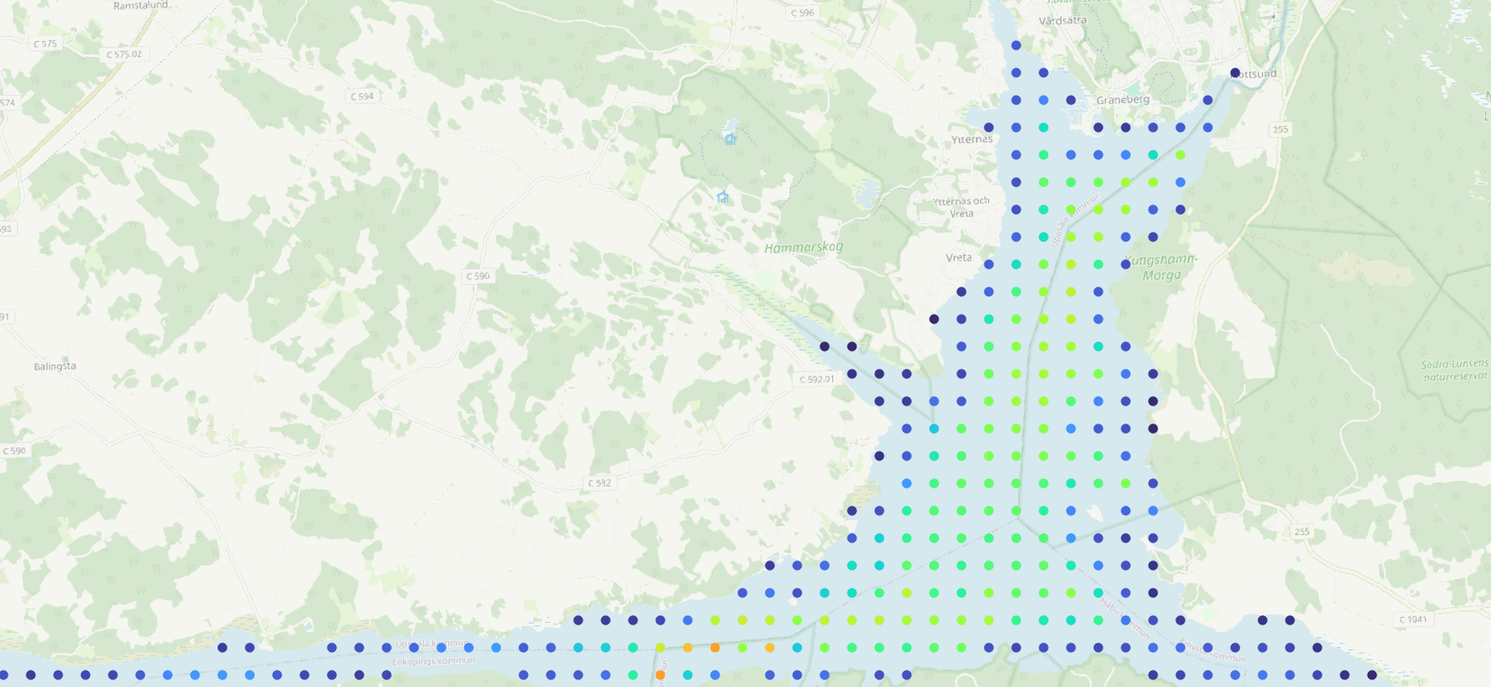
Point data
Raster 300m x 300m pixels
Average depth

Slide 3
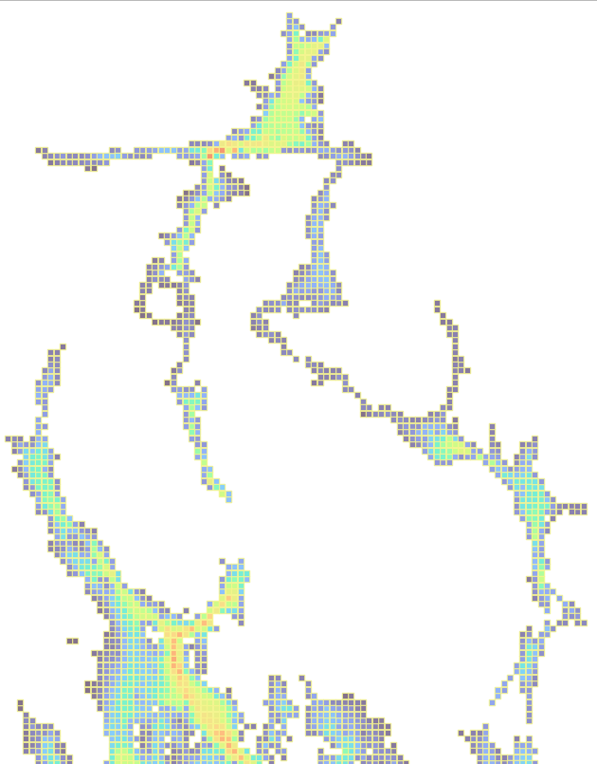
Missing connections

Slide 4
interpolate raster to get transport

Slide 5
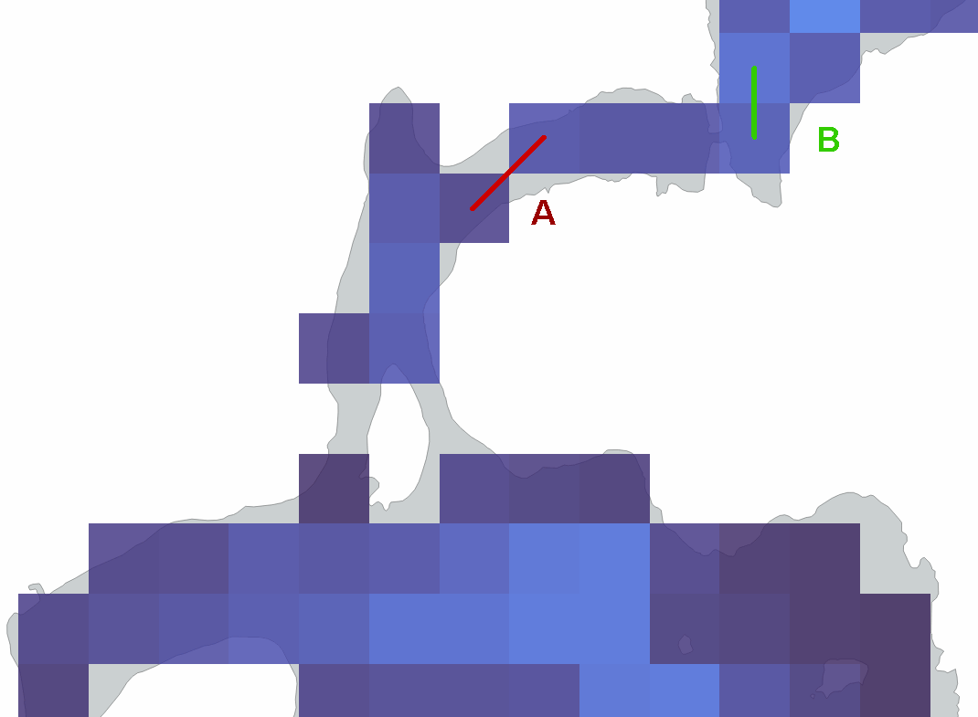

Slide 6
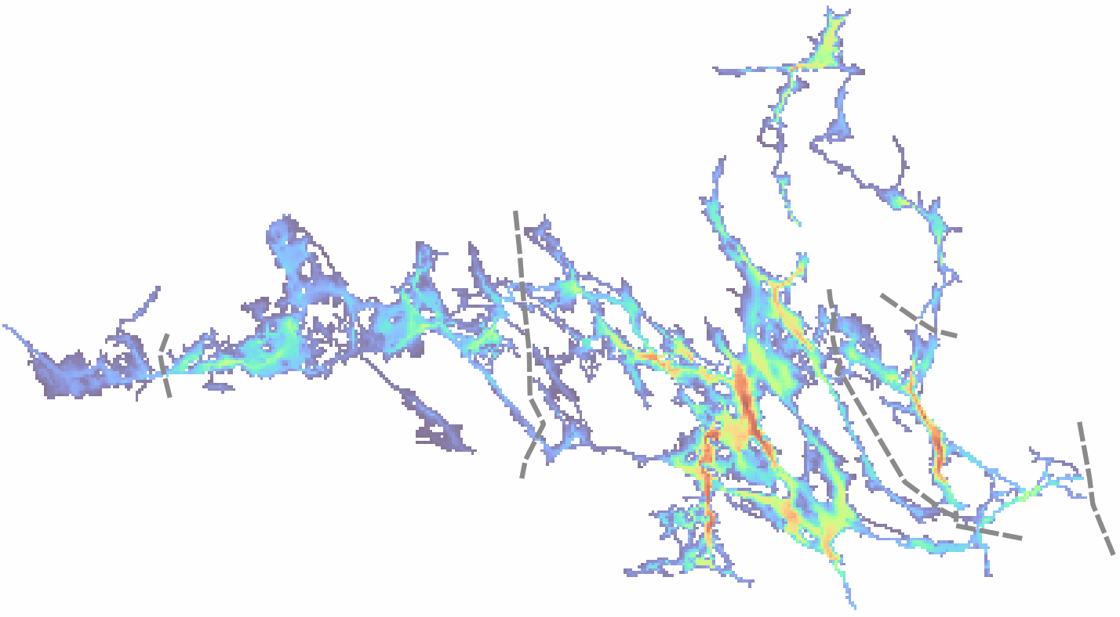
connect river inflow to shoreline pixels

