Slide 1
Initial Watershed Modeling
Lake Mälaren

Slide 2
Available Historical Data
Met Inputs are available for 13 sub-basins in the Mälaren watershed. Gridded data interpolated to produce mean basin inputs
Eobs 0.1 degree gridded 1950-2021
ISIMIP3a WFDE5 0.5 degree gridded 1961-2019
Measured discharge for calibration SMHI
Daily mean discharge
Record length 10y – 60y most sites over 60 years

Slide 3
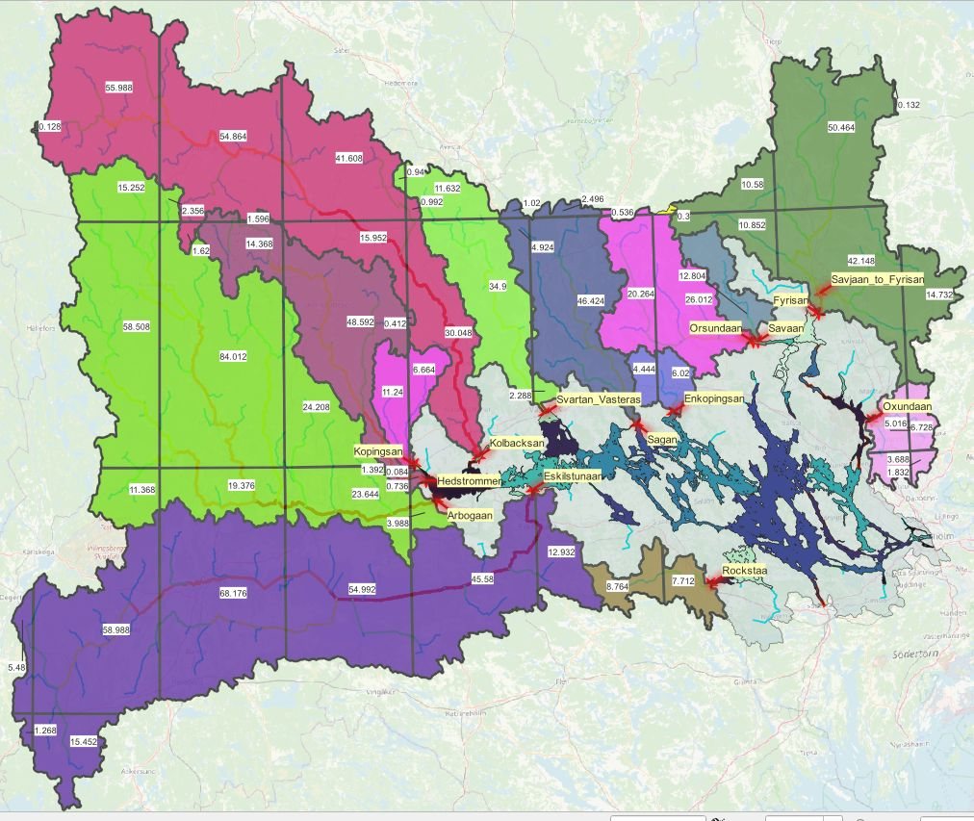
All Major Watersheds

Slide 4
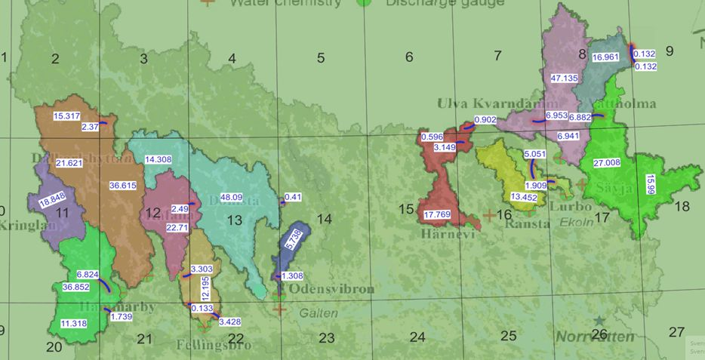
Watersheds with Measured Discharge

Slide 5
Calibrations and Simulations Using GWLF model
All 13 basins calibrated using Eobs NSE 0.7
Hydrology simulated using ISIMIP2
New Hydrology calibrations underway forced by ISIMIP3a

Slide 6
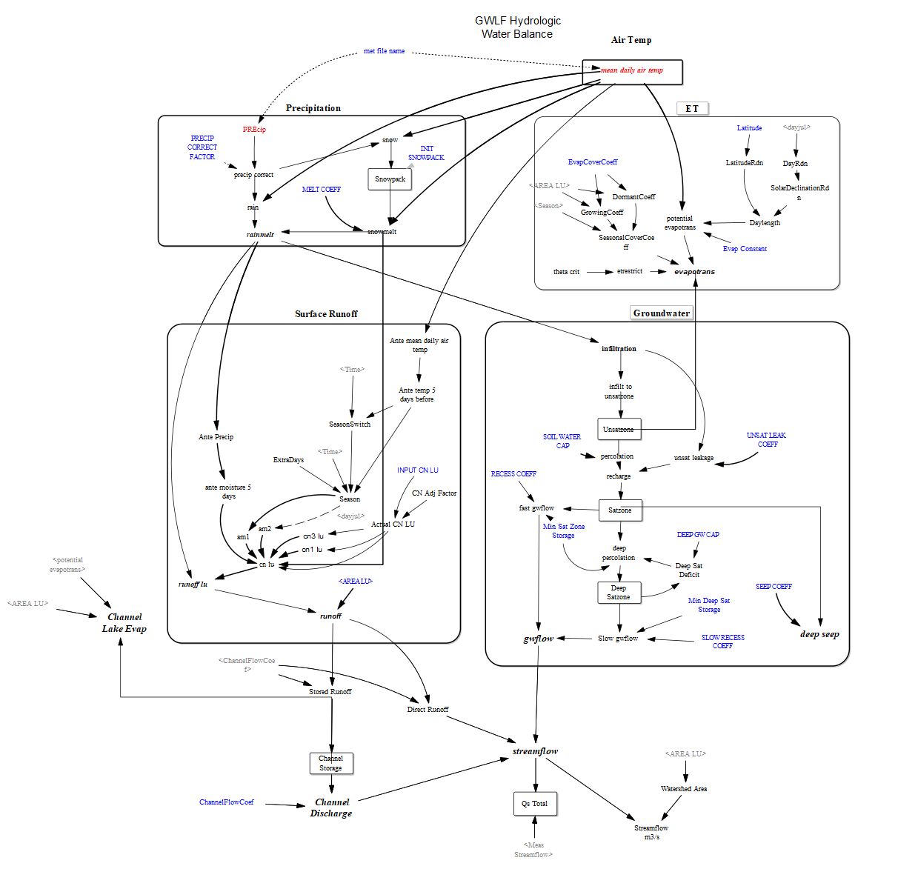
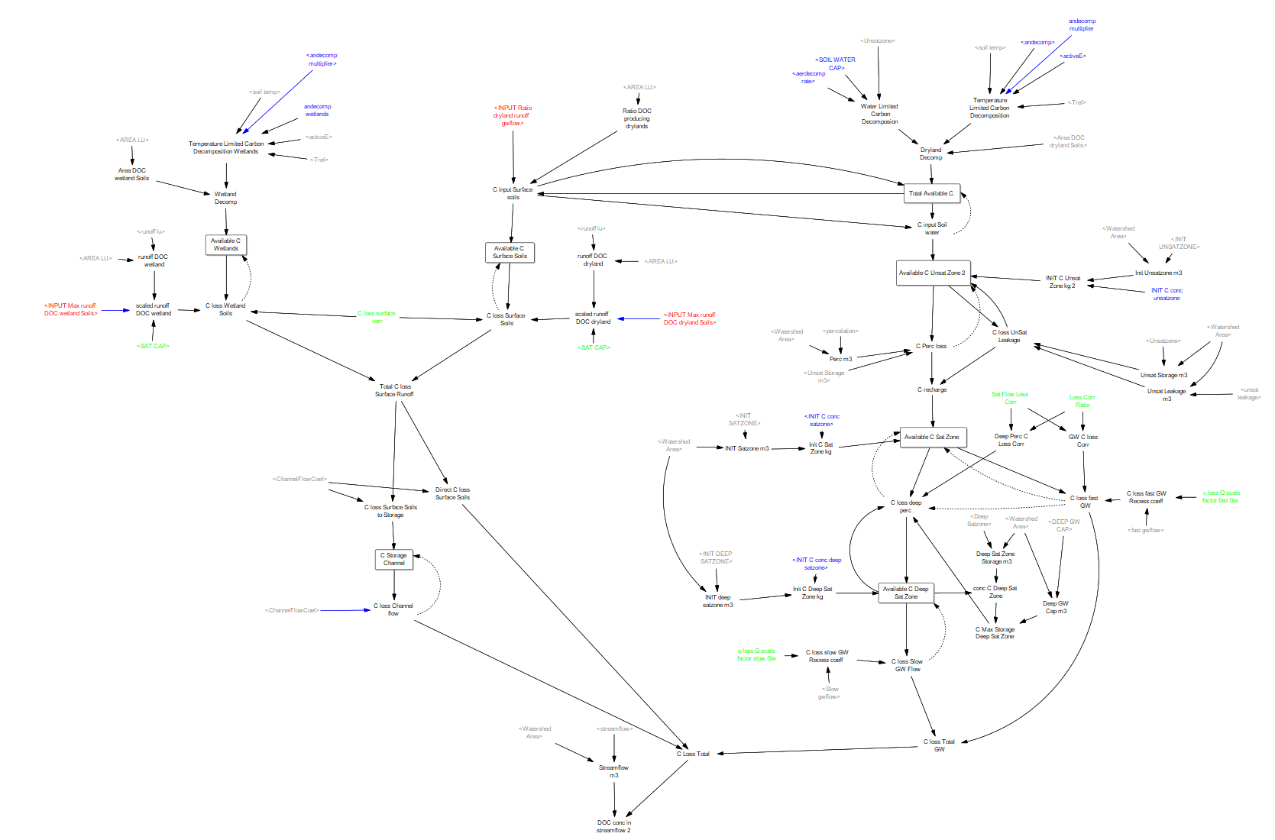
Future
Simulate historical hydrologic inputs from entire watershed.
Simulate ISIMIP3 future inputs for entire watershed
DOC inputs process based model coupled to GWLF
Nutrient inputs – need to decide on a method

